Slide 1

Comments, Operators, Condition

Slide 2
Comments
Anything after # is ignored by Python.
Why comments?
Describe what is going to happen in a sequence of code.
Example:
# compute the percentage of the hour that has elapsed
percentage = (minute * 100) / 60

Slide 3
Converting User Input
If we want to read number from a user, we must convert it from a string to a number using a type conversion function.
Write a program to prompt the user for hours and rate per hour to compute gross pay.
Enter Hours : 35
Enter Rate : 2.75
Pay : 96.25
Lets write our first program in VS Code

Slide 4
Comparison Operators
Boolean expressions using comparison operators evaluate to True/False or Yes/No.
Comparison operators look at variables but do not change the variables.
Python | Meaning
< | Less than
<= | Less than or Equal to
== | Equal to
>= | Greater than or Equal to
> | Greater than
!= | Not Equal

Slide 5
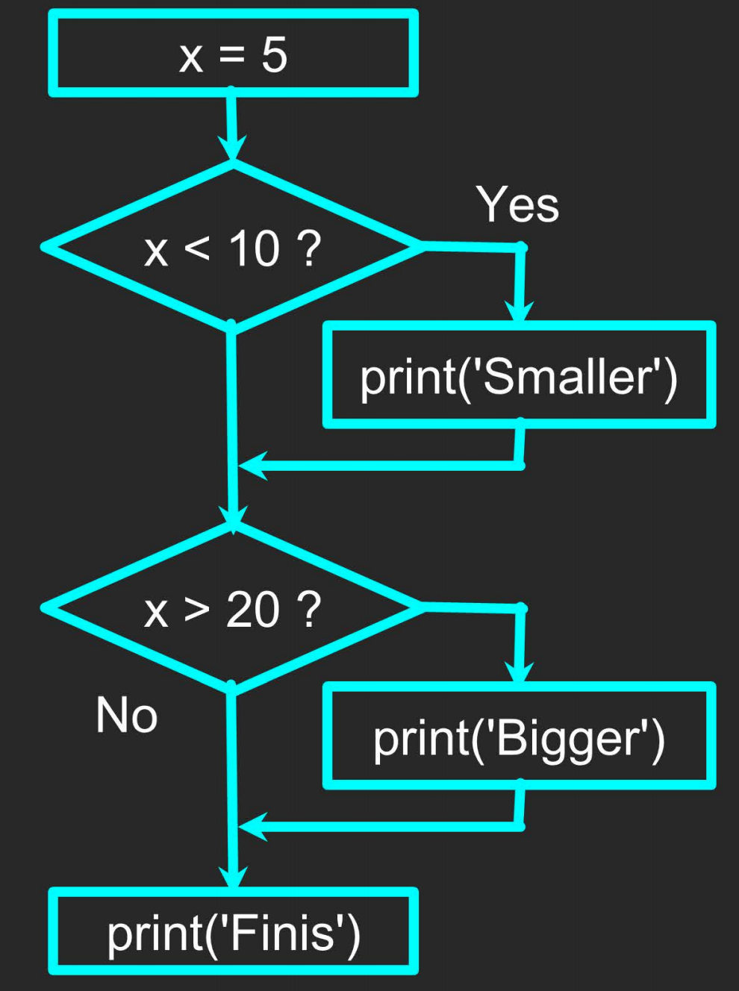
Conditional Steps
Program:
Try this in VS Code.
x= 5
if x<10:
print('Smaller')
If x>20:
print('Bigger')
print('Finish')
Guess the output and type it in Comment Section.

Slide 6
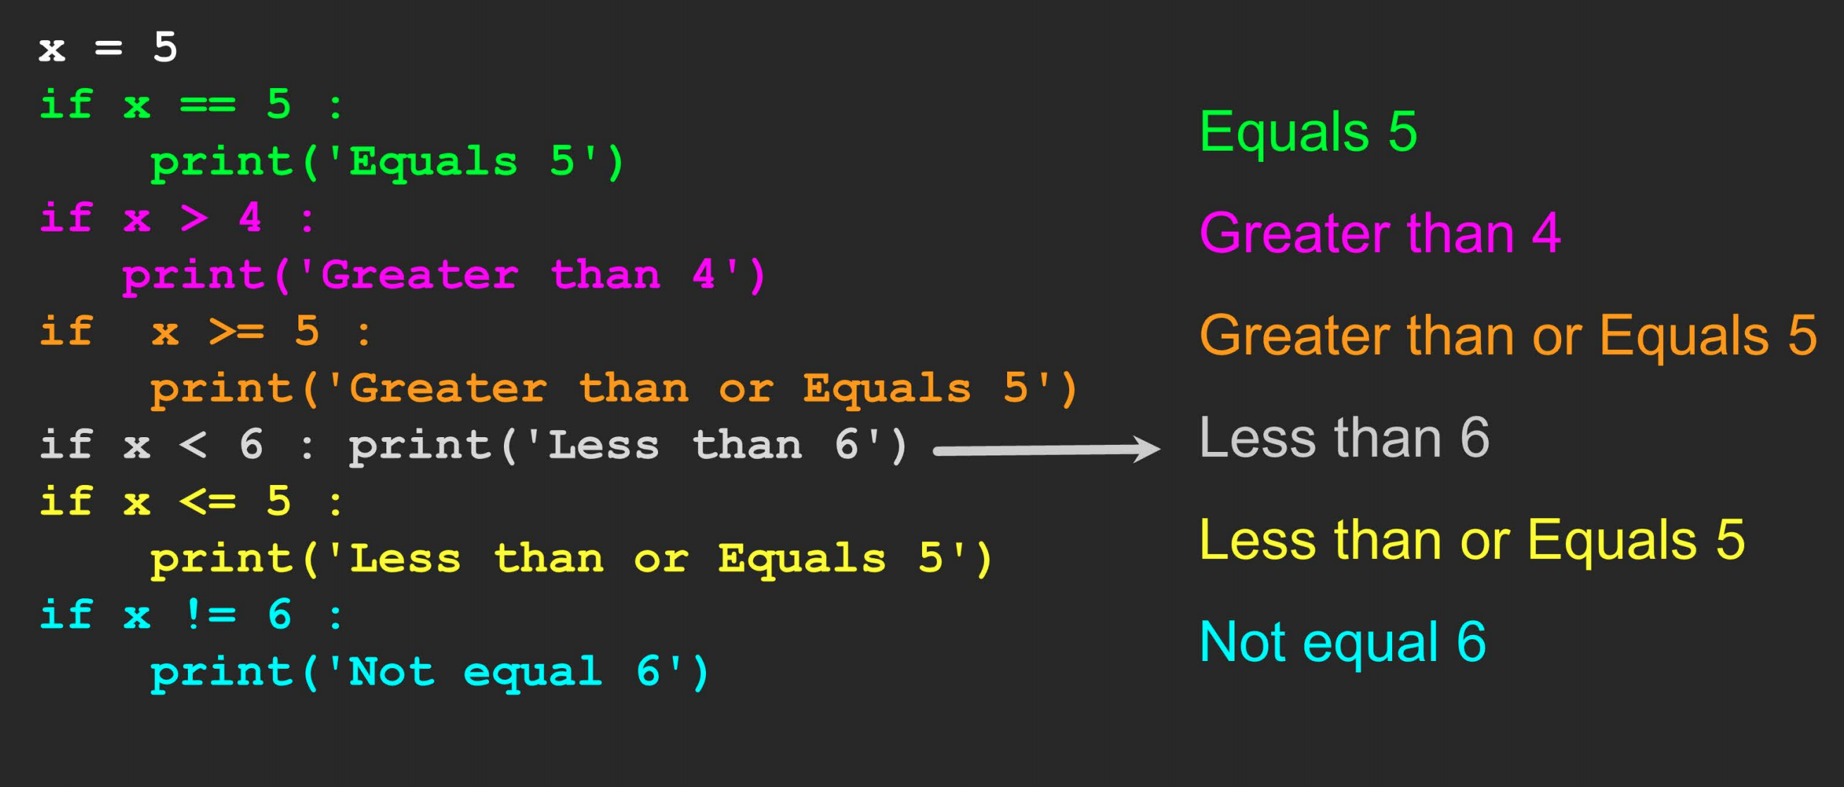
Comparison Operators

Slide 7
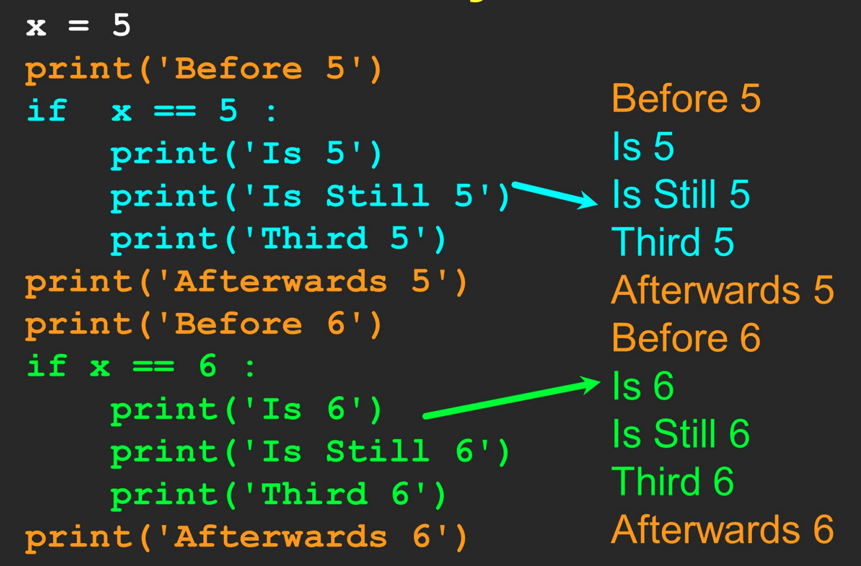
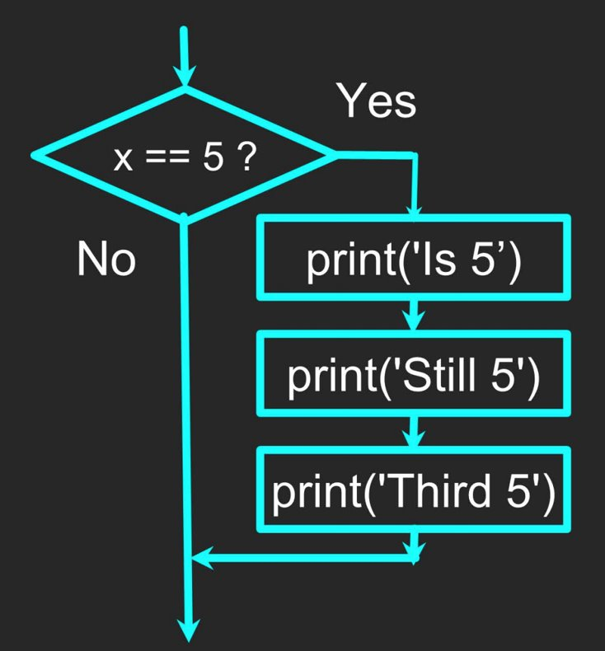
One Way Decisions

Slide 8
Indentation
Increase Indent after an if statement or for statement (after: )
Maintain indent to indicate the scope of the block (which lines are affected by the if/for)
Reduce indent back to the level of the if statement or for statement to indicate the end of the block
Blank lines are ignored-they do not affect indentation
Comments on a line by themselves are ignored with regard to indentation

Slide 9
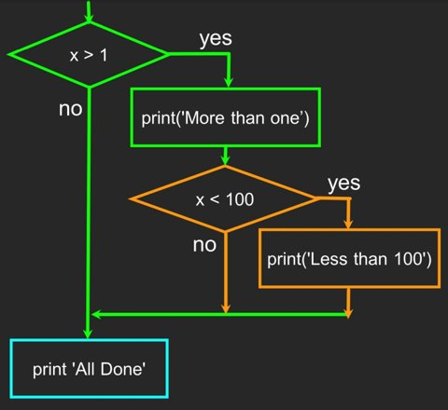
Nested Decisions
x= 42
if x>1:
print('More than one')
if x<100:
print('Less than 100')
print('All Done')

Slide 10
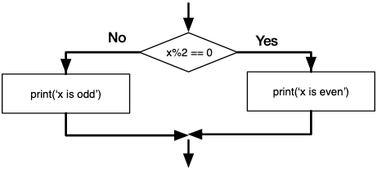
Two-way Decision with else:
if x%2 == 0 : print('x is even') else : print('x is odd')

Slide 11
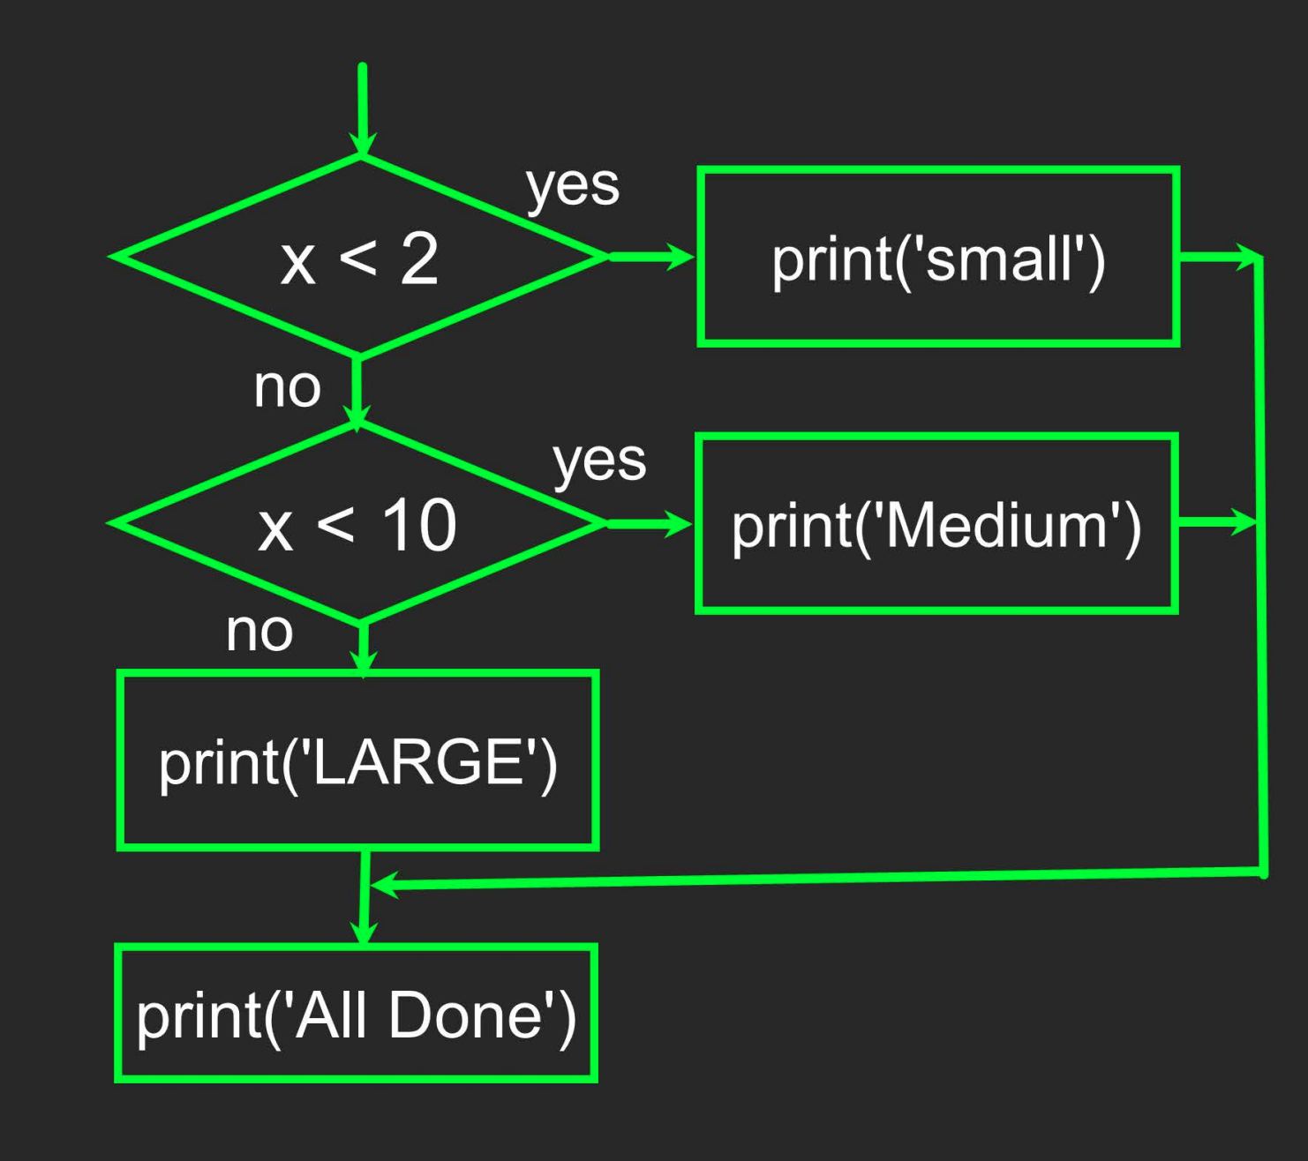
Multi-way
if x<2:
print('small')
elif x<10:
print('Medium')
else:
print('Large')
print('All Done')

Slide 12
Multi-way
x= input()
x= int(x)
if x<2:
print('Small')
elif x<10:
print('Medium')
elif x<20:
print('Big')
elif x<40:
print('Large')
elif x<100:
print('Huge')
else:
print('Ginormous')

Slide 13
Logical Operators
There are three logical operators:
and
or
Not
And operator gives True when both the statements are True otherwise False.
Or operator gives False when both the statements are False otherwise True.
Not operator reverses the value it converts True to False and vice versa.
Lets Try them in VS Code

Slide 14
Summary
Type
Reserved Words
Variables
Operators
Operator Precedence
Integer Division
Conversion between types
User input
Comments(#)
Comparison Operators
== <= < > >= !=
Indentation
One-way Decisions
Two-way Decisions:
If: and else:
Nested Decisions
Multiway Decisions using elif
Logical Operators

Slide 15
Like, Share and Subscribe to my Youtube Channel

